Slide 1
Analysing Criminal Behaviour
as a Complex System
Bonnie and Cellular Automata
Mika Doorenbosch, Ruben Lanjouw, Liesbet Ooghe, Francesco Tiepolo
Notes:
Liesbet

Slide 2
Introduction
Criminal behaviour is rampant around the world with no end in sight!!
Notes:
Liesbet

Slide 3
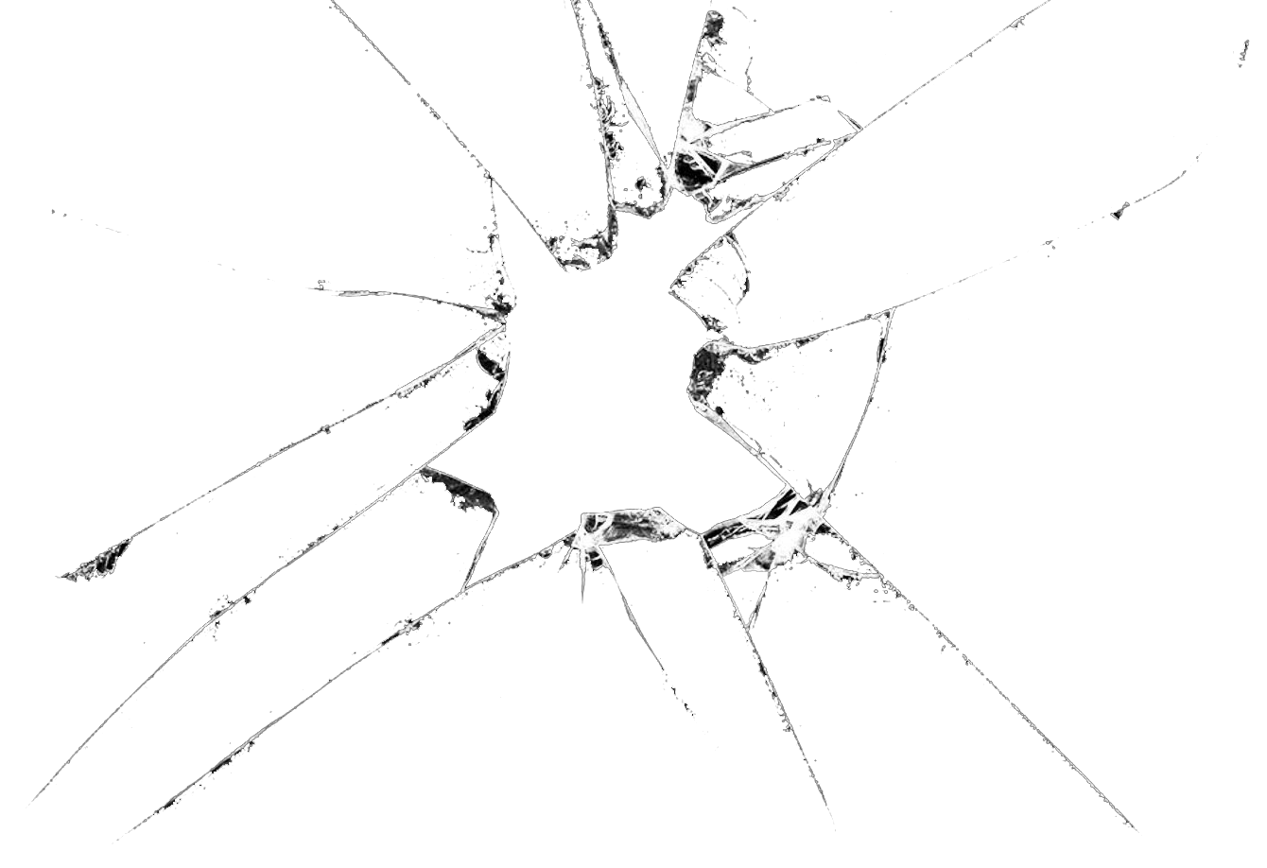
Introduction
Criminal behaviour in urban areas behaves like a complex system.
Broken Window Theory: Something as simple as vandalism will invite and encourage crime when left unaddressed.
Crime spreads to nearby areas.
Notes:
We split our formula into positive and negative next to each other.
We want to include gamma which only affects negative influence.
We wanted to make our transition function really based on “if there are
The broken window theory states that the crime will spread to other neighb

Slide 4
Cellular Automata
Notes:
Liesbet
Since all the areas around the cell have a higher criminality, the criminality of the cell will increase in the next timestep. How much exactly does the value of the cell change? Let’s look at the transition function!

Slide 5


Cellular Automata
Transition function:
Additional condition:
If M or L is an empty set, then is doubled.
Notes:
Liesbet
C_{t+1} is a cell’s criminality value in next timestep
\alpha is a parameter defining how much the value of the cell at timestep t affect the next value
C_t is the criminality value of the cell at timestep t
\beta is a parameter defining how much the neighbour’s values affect the new value. \beta is equal to 1-\alpha
\gamma is a parameter that’s based on the average of the cell’s education and income value. Every cell gets a random value assigned for income and for education to simulate a diverse city environment. Since both education and income are uniform random distributions, their average is a triangle distribution.
M is the average criminality value of the neighbours with more criminality
L is the average criminality value of the neighbours with less criminality
The reason that M and L are separate is because education and income values a neighbourhood will affect how much negative neighbours will affect.

Slide 6
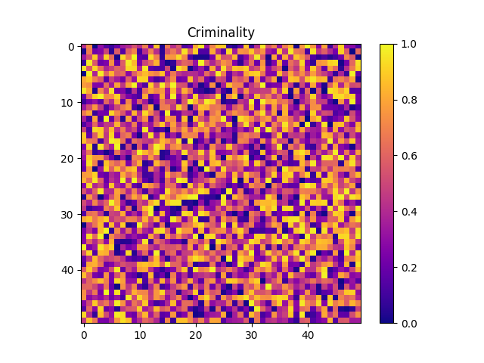
In Practice
Initial Criminality
Animation
Notes:
Ruben

Slide 7
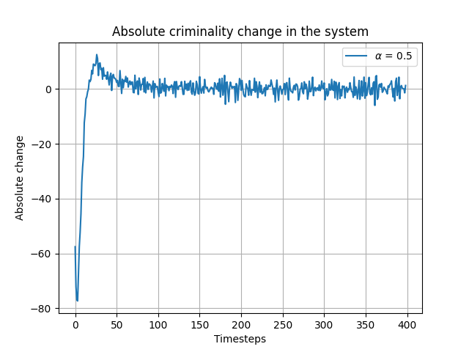
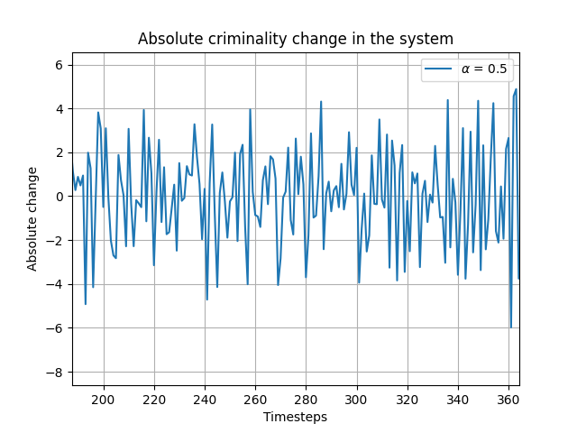
Oscillations
Notes:
Ruben

Slide 8
Police Intervention
Rule set for police:
Number of units
Threshold
Effect on criminality
Redistribution fraction
Notes:
Ruben

Slide 9
Police in Practice
without police
with police
Notes:
Ruben
-0.8 intentionthreshold, 0.8 effect, 0.7 redistrubutation (50% of 0.8) over neighbours, 30 police

Slide 10
Hypothesis 1
For a high enough influence difference, we can observe
the emergence of a giant component in the grid.
Notes:
Francesco

Slide 11
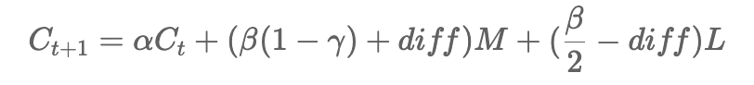
Emergence of Giant Component
Relevance in the crime domain (D'Orsogna & Perc, 2015)
Network structure is pivotal in criminality study
Gangs, cartels, organized crime,...
Connection threshold
Emergence of giant component as phase transition from localized to organized criminality
Difference in influence (“Social norm to accept crime” (p. 8))
Notes:
Francesco

Slide 12
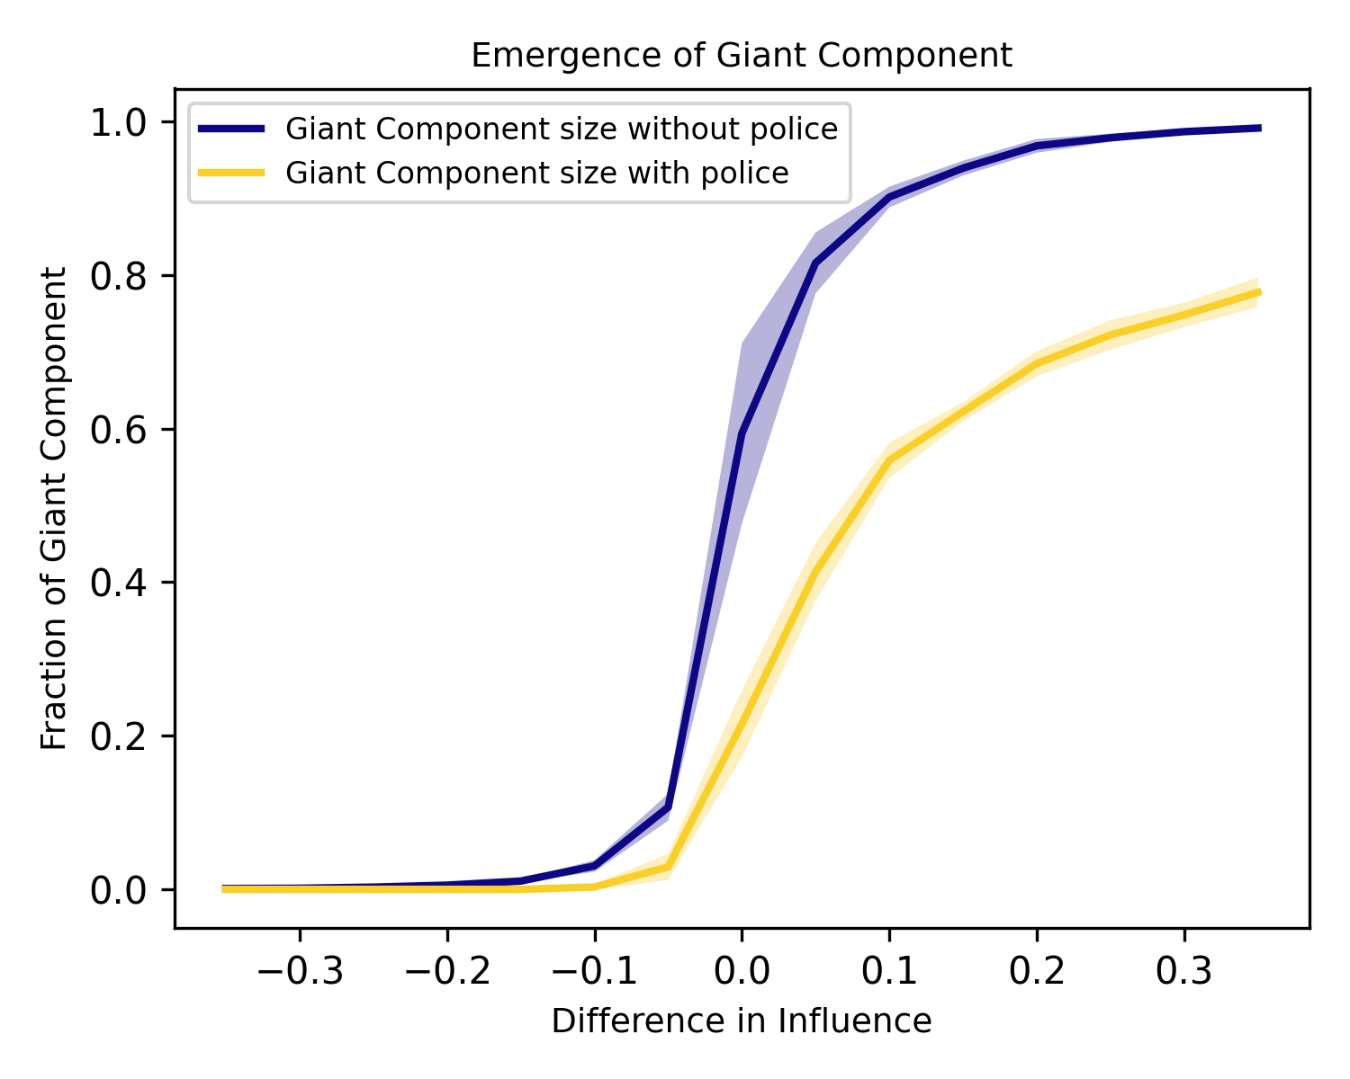
Emergence of Giant Component
Notes:
Francesco

Slide 13
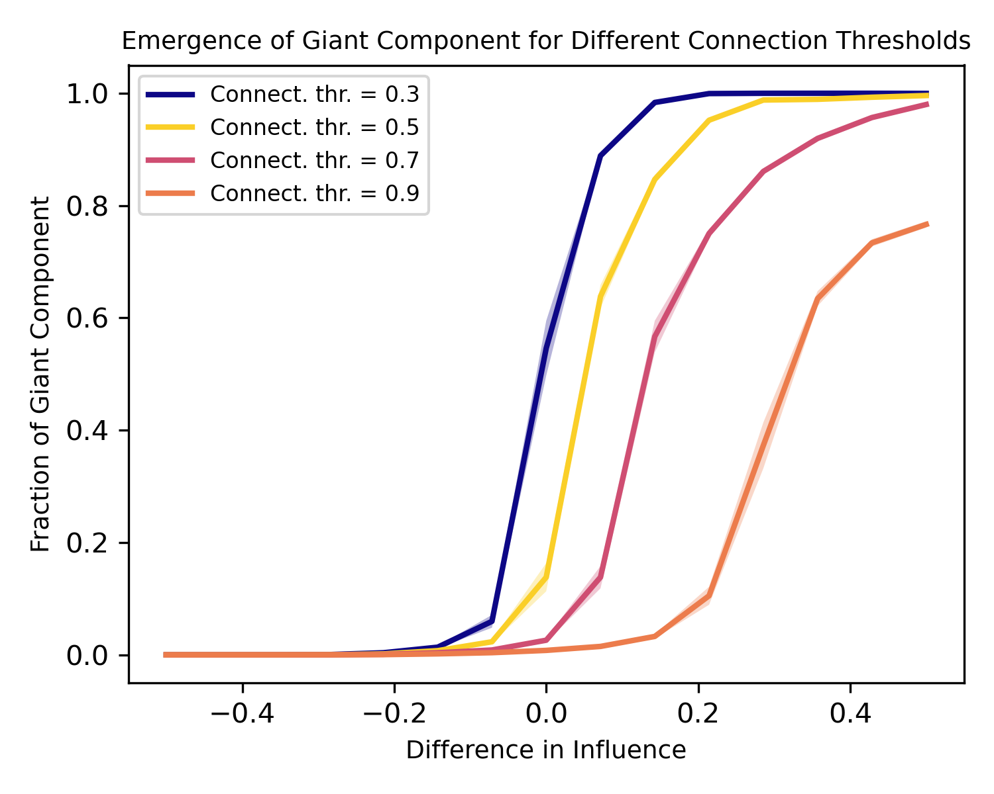
Emergence - Connection Threshold
Notes:
Francesco

Slide 14
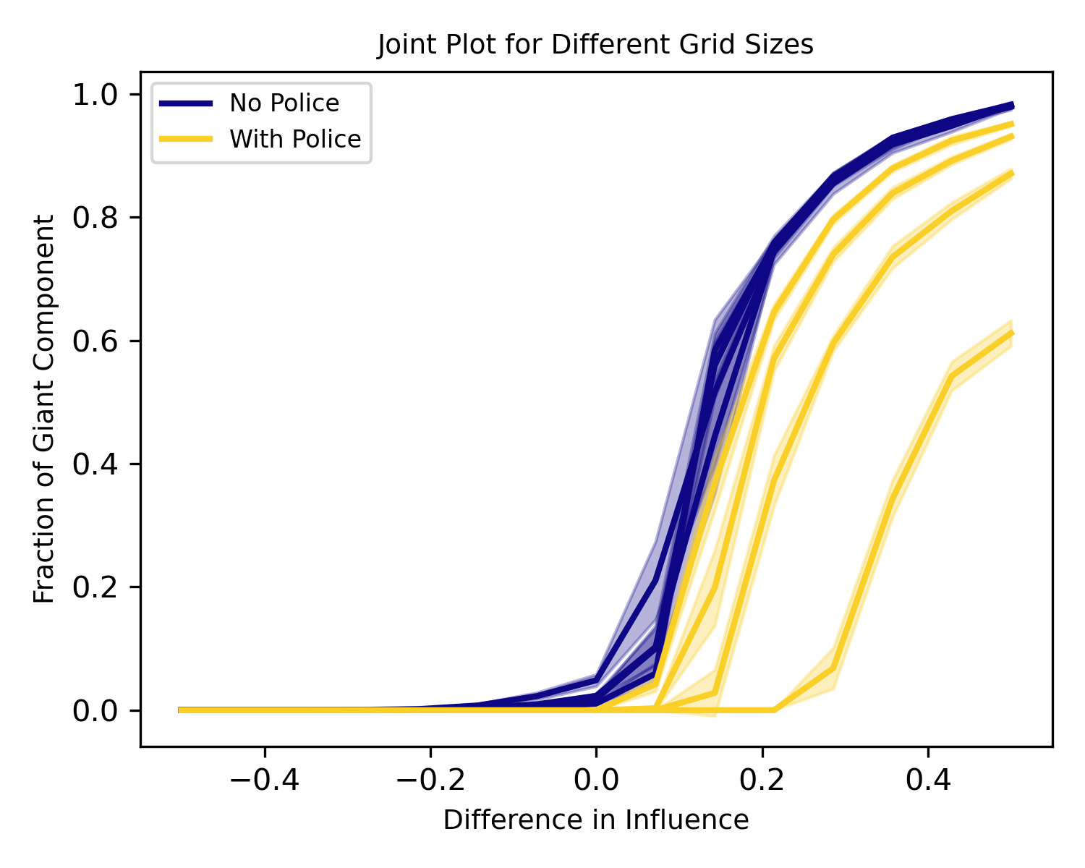
Emergence - Scale Free

Slide 15
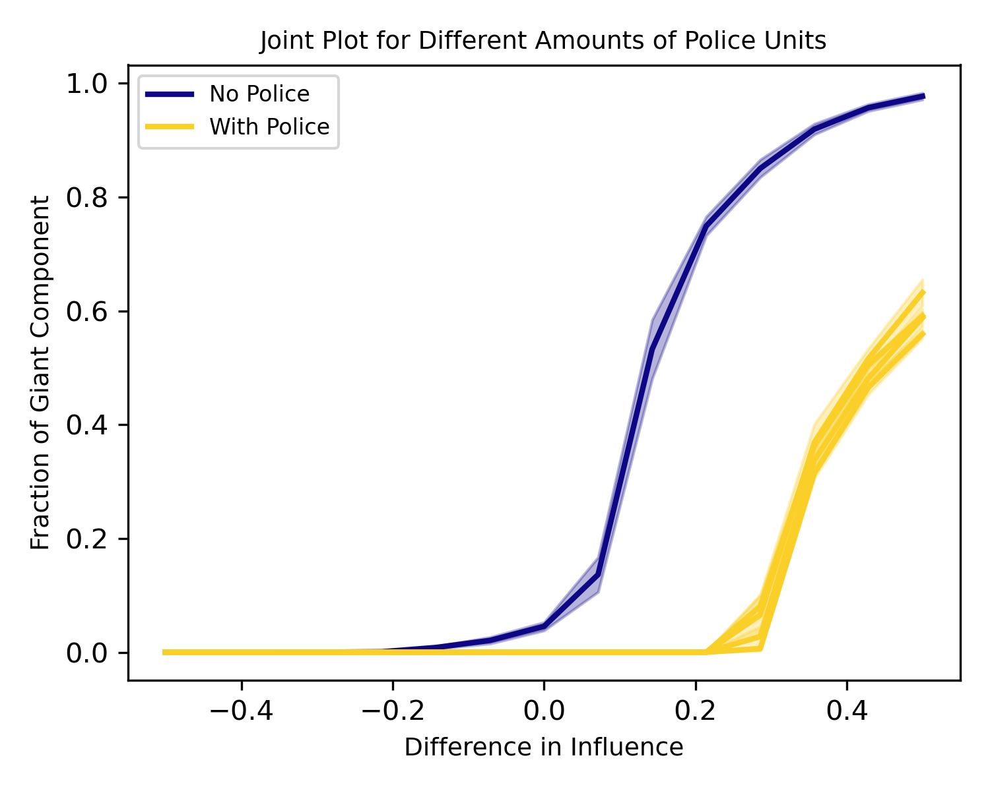
Emergence - Finite Scaling
(police correction)

Slide 16
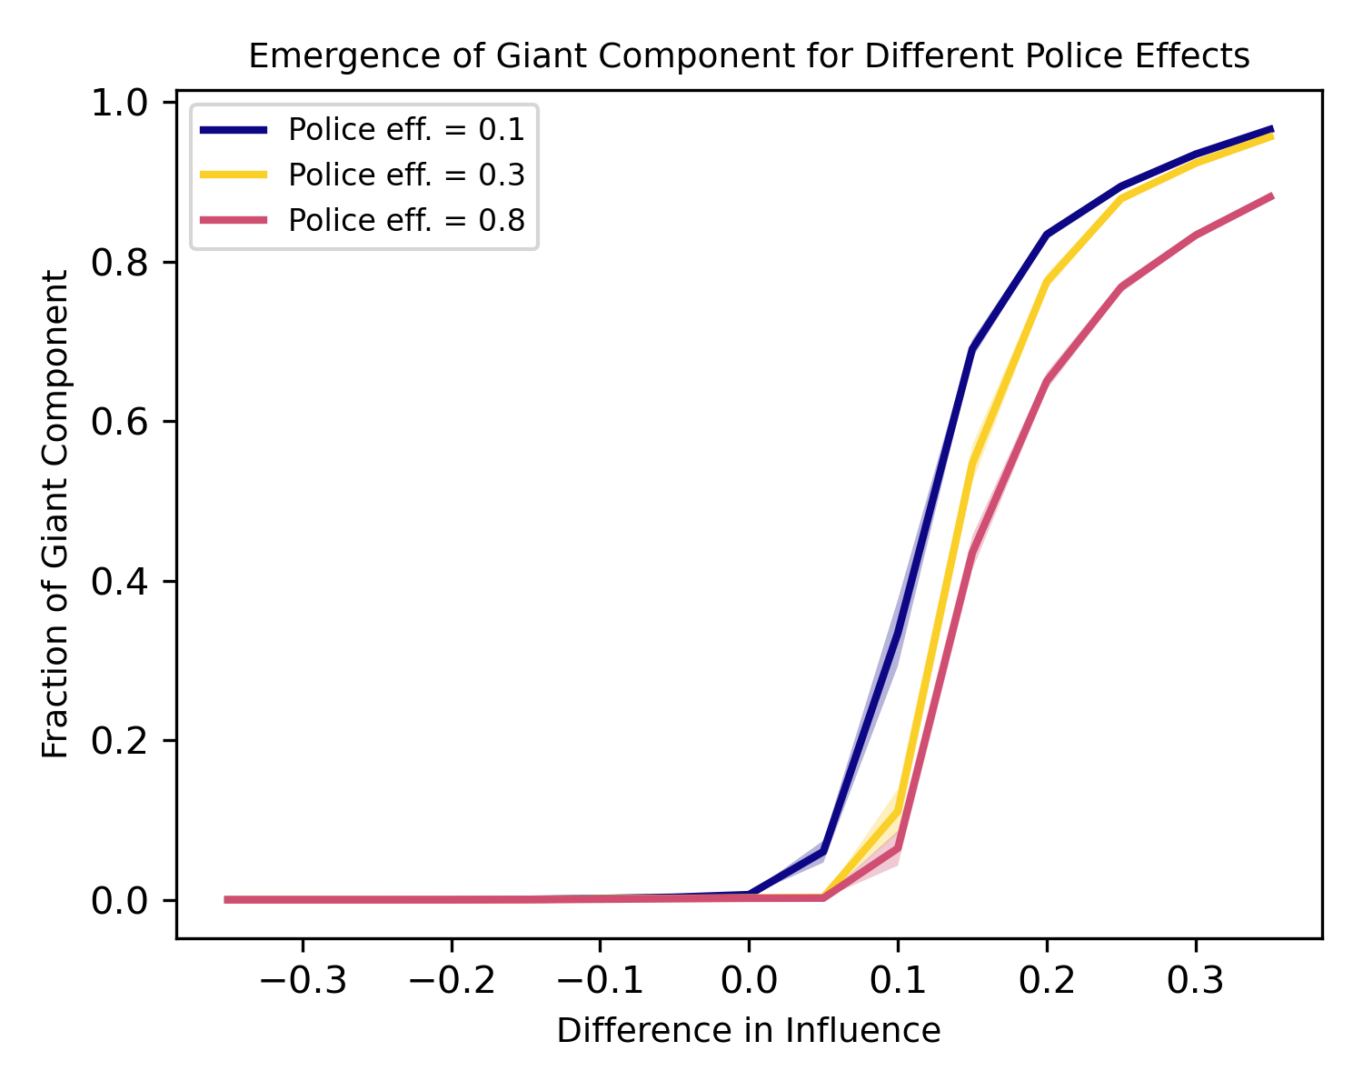
Emergence - Different Police Effects

Slide 17
Hypothesis 2
Self-organised criticality will be observable in the model.
Notes:
Fransesco

Slide 18
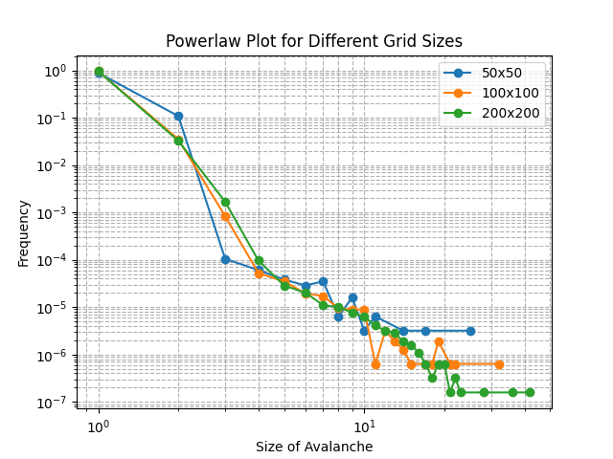
SOC
Non-equilibrium steady state
Observable avalanches
Lack of slow drive and build-up
of stress
Notes:
Mika
We don’t

Slide 19
Conclusion
Emergence of giant component
Lack of evidence for SOC
Influence difference and police activity can slow or accelerate spread
Further Research
Comparing the simulation to real-life data
Effects of the alpha to beta ratio
Notes:
Mika

Slide 20
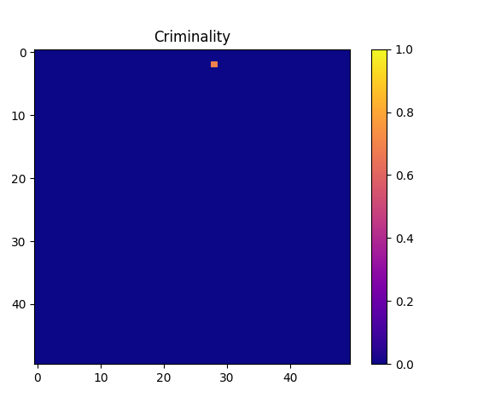
Broken window theory in practice
Notes:
Mika

Slide 21
References
D'Orsogna, M. R., & Perc, M. (2015). Statistical physics of crime: A review. Physics of life reviews, 12, 1-21.
Manning, R. (2021, December 13). Predicting Crime Levels with Cellular Automata. Medium. https://ray-90807.medium.com/predicting-crime-levels-with-cellular-automata-ffb3928f1be5

Slide 22
Example
0.0
0.1
0.0
1
1
0.8
0.9
0.0
0.5
0.0
0.1
0.5
0.1
0.0
0.0
0.0
0.0
0.0
0.0
SUM = 2.5
SUM = 2.66
Notes:
Ruben

